Slide 1
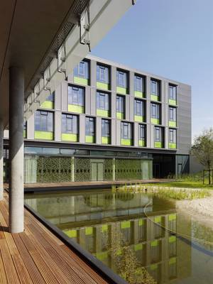
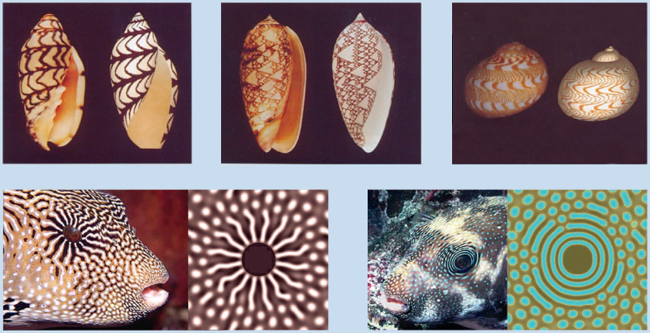
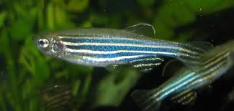
Pattern Formation in Tissues
Walter de Back,
Fabian Rost,
Lutz Brusch
ZIH,TU Dresden
Kondo and Miura 2010, Science 329, 1616.

Slide 2
Agenda
Aims
Translation of the sketch of a mechanism into a mathematical model
Characterisation of pattern forming processes
Understand theory papers
Own models in Morpheus simulation framework
Methods encountered during the week:
Reaction-diffusion models, Cellular Potts models
Role of initial state and of parameter settings for pattern formation
Planning, performing and analysing model simulations
Hands-on Linux
Keep electronic protocol, notes, figures

Slide 3
Agenda
 | Monday |  |  | Tuesday |  | Wednesday |  | Thursday |  | Friday
0
1
2
3
4
5
Mo Module 0: Introduction (Lutz)
Mo Module 1: Modeling workflow (Fabian)
Tue Module 2: Morphogen gradients + Literature study (Lutz)
Wed Module 3: Model comparison: Vascular patterning (Walter)
Thu Module 4: Model refinement: Morphodynamics (Fabian&Walter)
Fri Module 5: Top-down modeling, project examples, summary (Lutz)

Slide 4
Models
Test hypothesis, counter-intuitive behavior
Infer hidden properties
Human -> model organism
-> conceptual model
-> mathematical model
-> model implementation
Bottom-up vs. top-down models

Slide 5
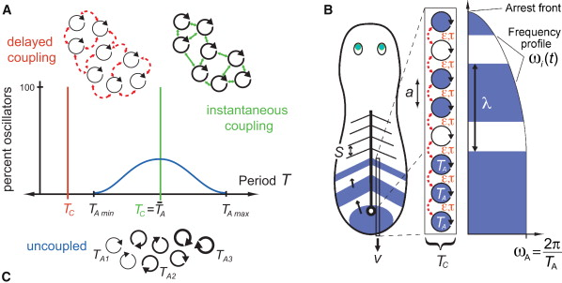
Top-down model: Somitogenesis
Herrgen et al., Current Biology, 20, 1244-1253 (2010)

Slide 6
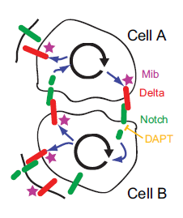
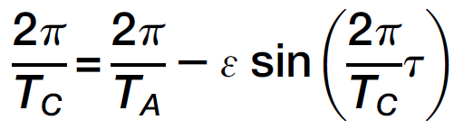
Top-down model: Somitogenesis
Herrgen et al., Current Biology, 20, 1244-1253 (2010)

Slide 7
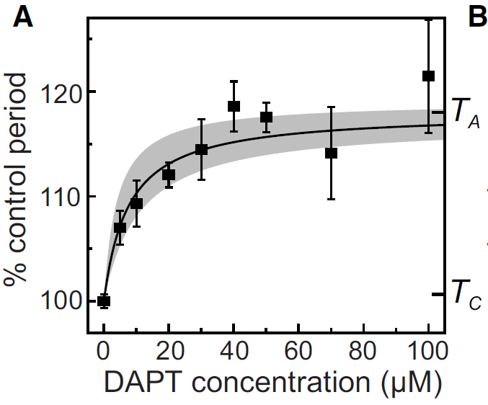
Top-down model: Somitogenesis
Herrgen et al., Current Biology, 20, 1244-1253 (2010)

Slide 8
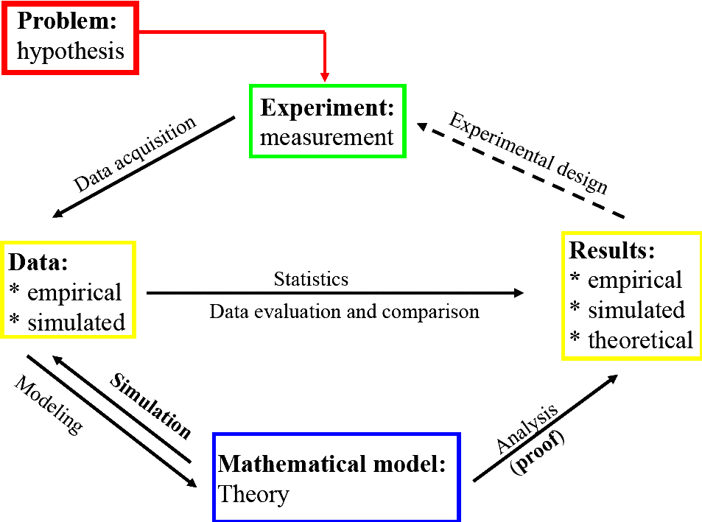
Interdisciplinary workflow

Slide 9
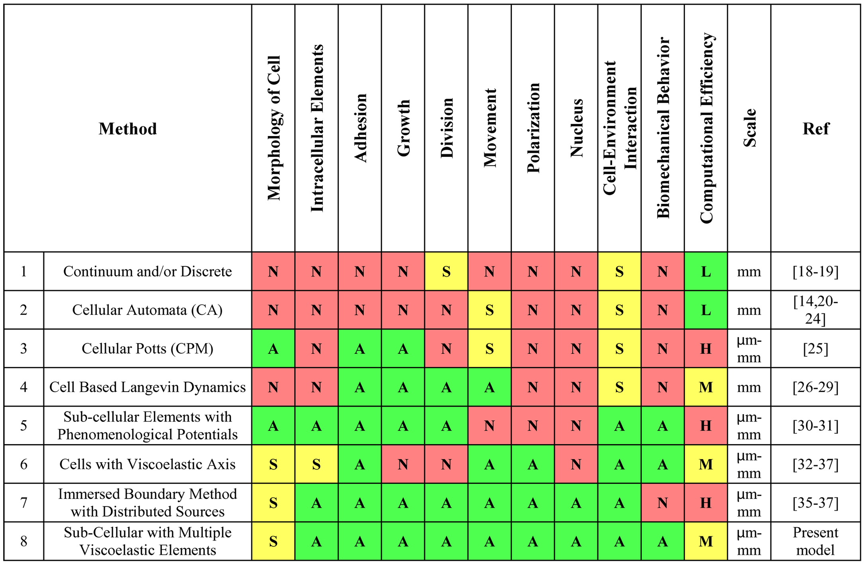
Different model types for cell mechanics

Slide 10
Central questions
How is a complex pattern encoded in the genome?
How can a pattern evolve?
Kondo and Miura 2010, Science 329, 1616.

Slide 11
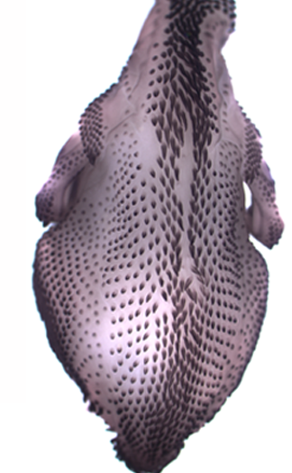
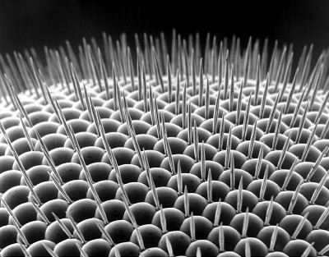
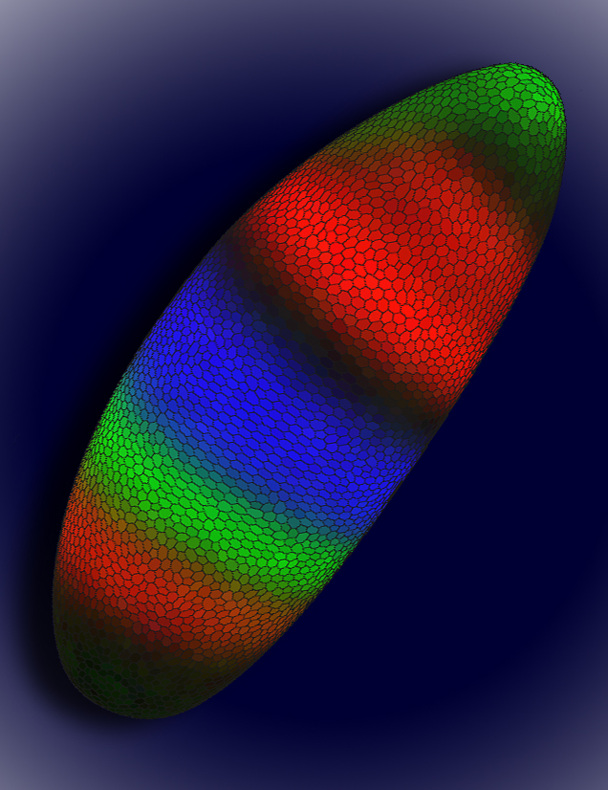
Central questions
How is a complex pattern encoded in the genome?
How can a pattern evolve?
Kondo and Miura 2010, Science 329, 1616.

Slide 12
Central questions
How is a complex pattern encoded in the genome?
How can a pattern evolve?
Prepattern vs. self-organisation
Roots in physics, chemistry
Mathematical theory
Applications to Biology
Kondo and Miura 2010, Science 329, 1616.

Slide 13
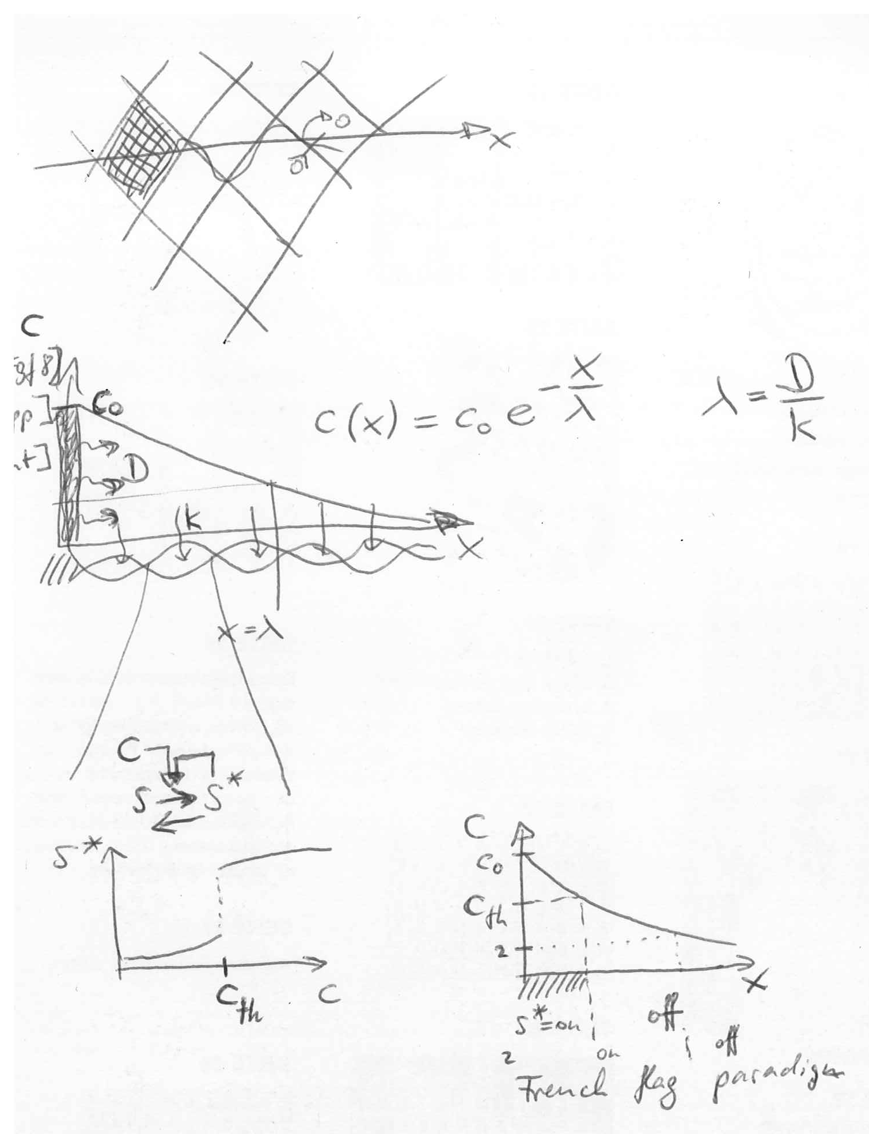
Pattern formation from pre-pattern

Slide 14
Self-organising pattern formation
Roots in physics
Second law of thermodynamics: all isolated systems approach a state of maximum disorder.

Slide 15
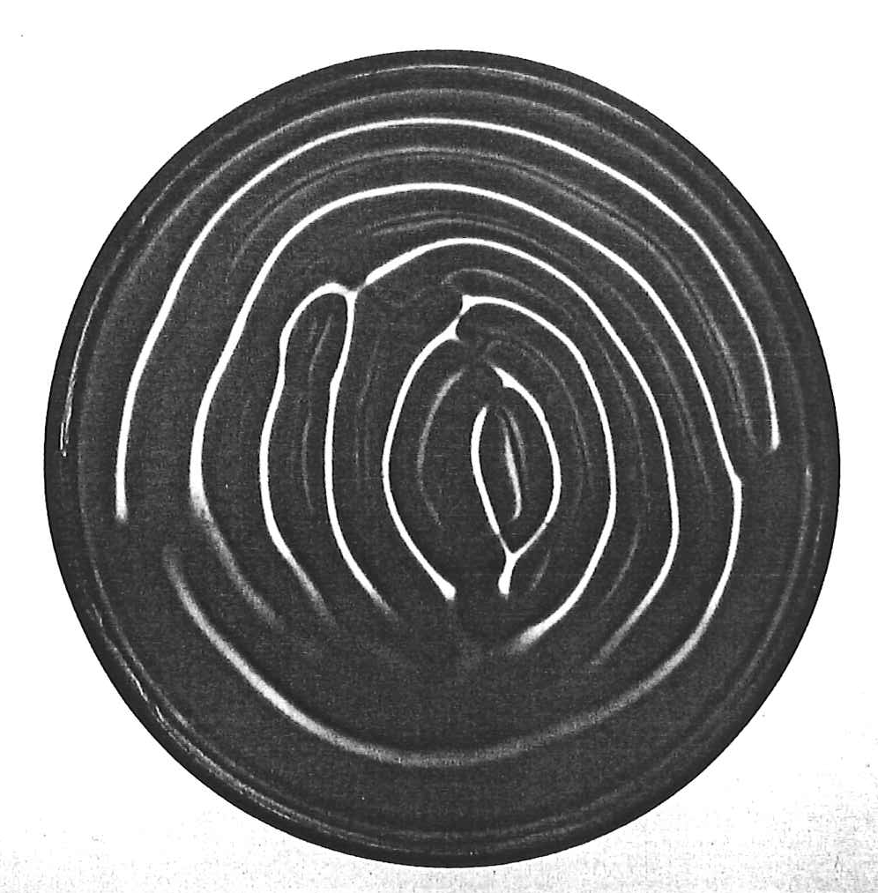
Experiment
starting from homogeneous solution

Slide 16
Roots in physics
Second law of thermodynamics: all isolated systems approach a state of maximum disorder.
Erwin Schrödinger, 1944: What Is Life?
Open systems increase and maintain order at expense of disorder in their environment.
Flux of energy and material through living system.

Slide 17
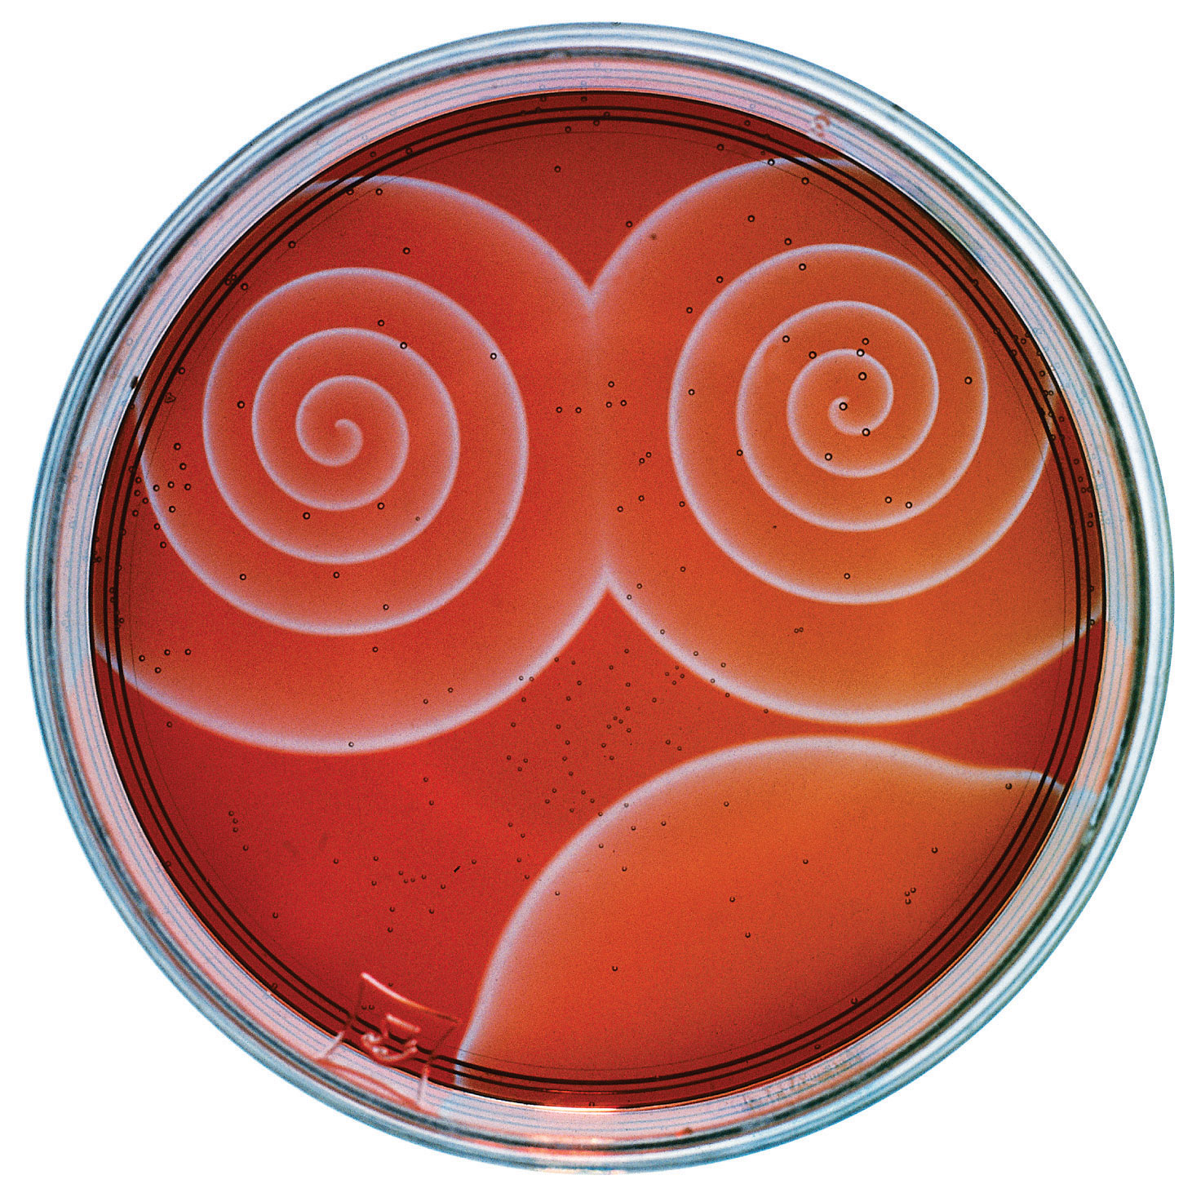
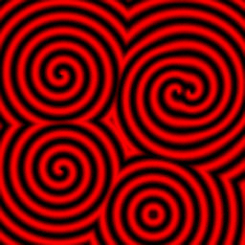
Belousov-Zhabotinsky reaction

Slide 18
Roots in chemistry
1951 - Boris P. Belousov discovers oscillatory reaction but cannot publish his data
1961 - Anatoly Zhabotinsky re-discovers recipe and observes travelling waves, spirals
1977 - Nobel Prize in Chemistry to Ilya Prigogine
"for his contributions to non-equilibrium thermodynamics,
particularly the theory of dissipative structures“
“self-organisation of complex patterns in simple systems”

Slide 19
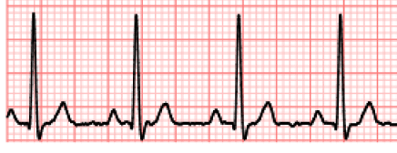
Def.: 3 classes of self-organising patterns
Steady state pattern: fixed non-homogeneous distribution of cell types or molecule concentrations as function of spatial position
Yet, this is no equilibrium: energy and
matter circulate in and out of the system.
Rhythm: ordered, homogeneous temporal signal, e.g. electrocardiogram, circadian rhythm
Coherent structure: ordered, propagating wave or pulse,
e.g. action potential travelling along axon
x
t
x-vt

Slide 20
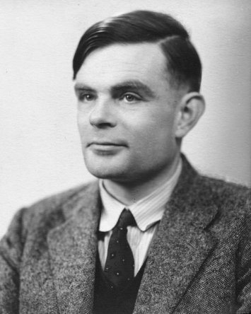
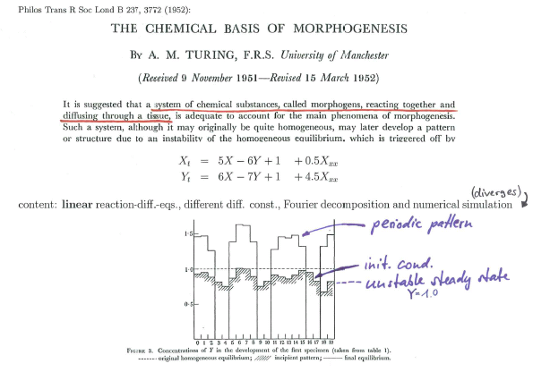
Alan Turing
60th anniversary
Roots in mathematics

Slide 21
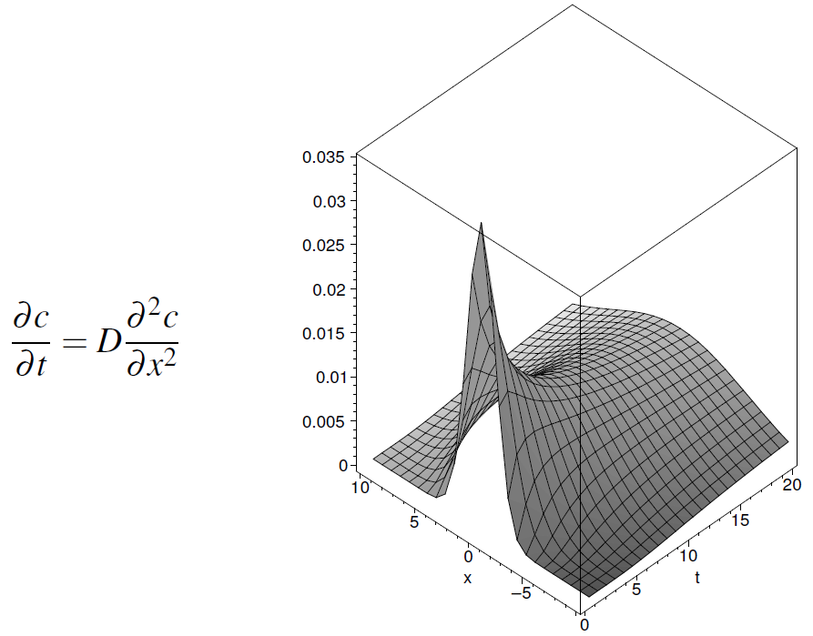
Diffusion alone smoothens

Slide 22
Alan Turing (1952)

Slide 23
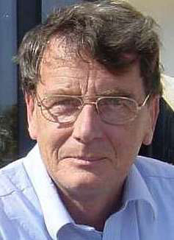
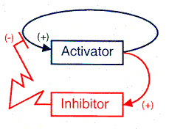
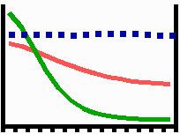
Gierer-Meinhardt principle: local activation, lateral inhibition
Gierer, A. and Meinhardt, H. (1972).
A theory of biological pattern formation. Kybernetik 12, 30-39.
Notes:
23

Slide 24
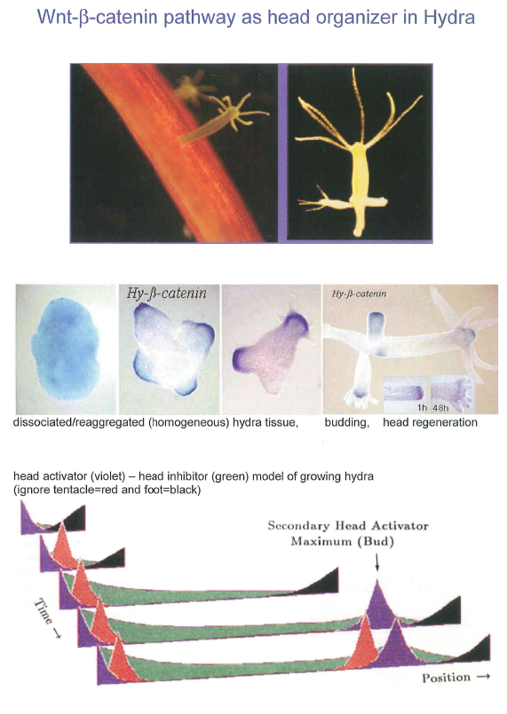
Hobmayer et al. 2000
Meinhardt 1982

Slide 25
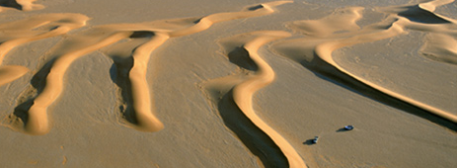
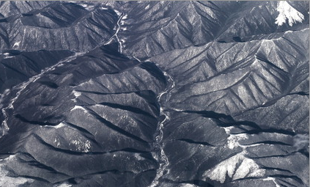
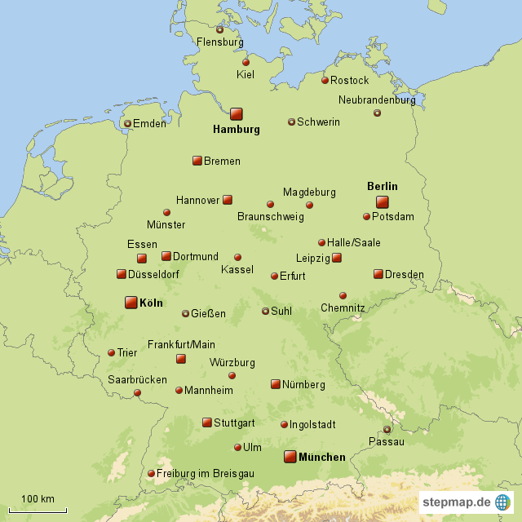
Patterns in other areas, same principle
Sand dunes
Erosion
Settlements

Slide 26
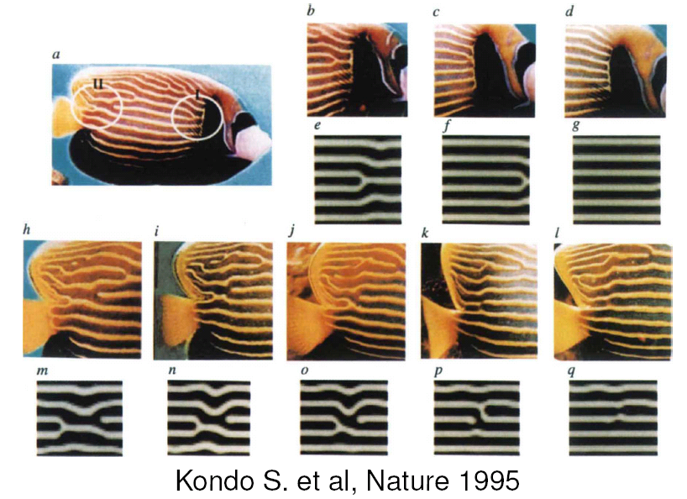

Slide 27
Simulations reproduce complex shell and fish patterns
Kondo and Miura 2010, Science 329, 1616.

Slide 28
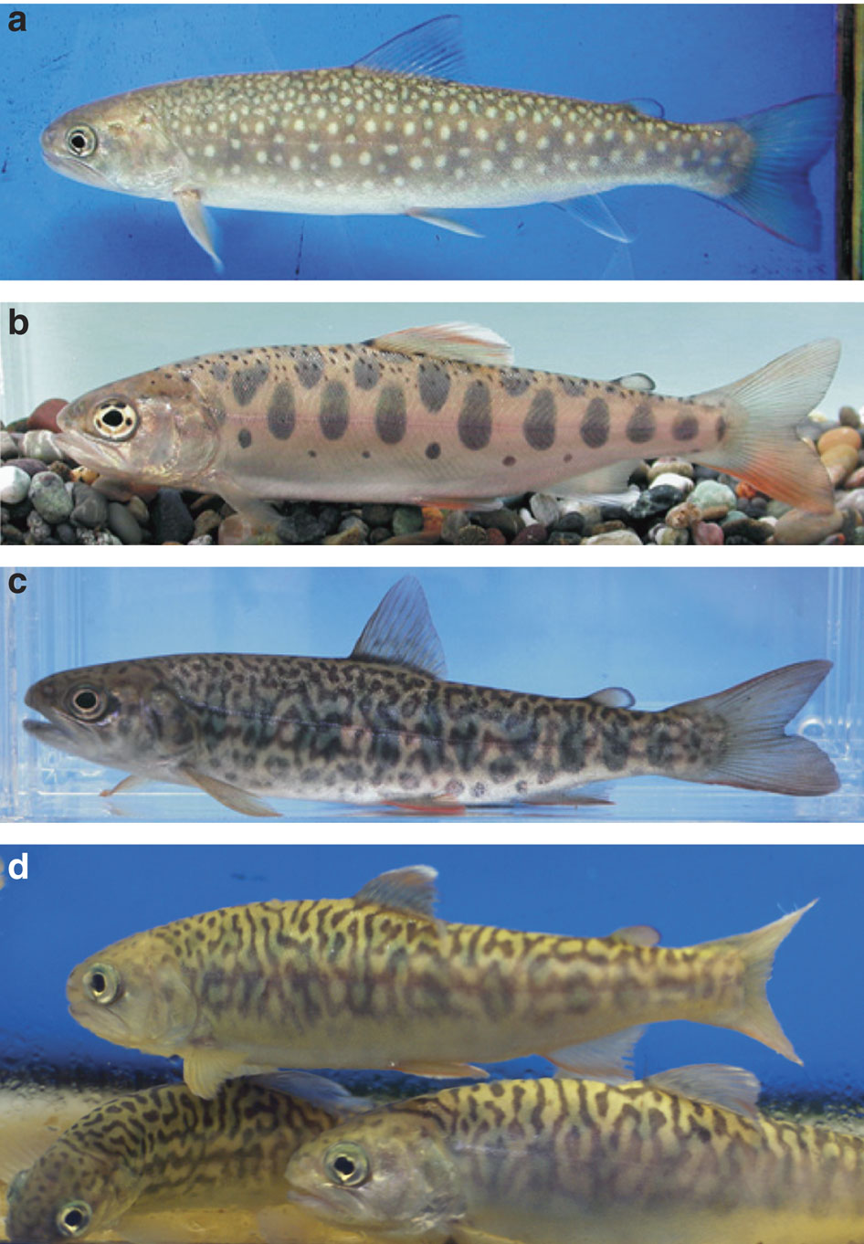
Pattern hybridization
white spots + dark spots = ?
Miyazawa et al., Nature Comm.1, 66

Slide 29
Pattern hybridization
white spots + dark spots = labyrinth
Miyazawa et al., Nature Comm.1, 66

Slide 30
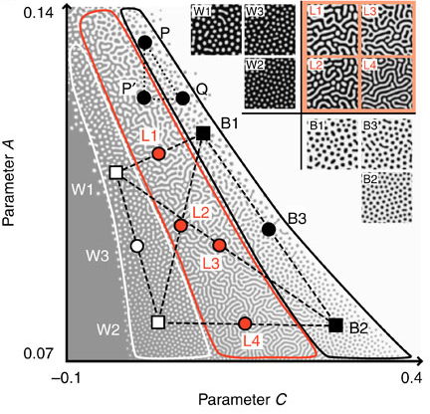
Pattern hybridization
Miyazawa et al., Nature Comm.1, 66

Slide 31
Central questions
How is a complex pattern encoded in the genome?
How can a pattern evolve?
Kondo and Miura 2010, Science 329, 1616.

Slide 32
Literature
A. Turing (1952) The Chemical Basis of Morphogenesis. Phil. Trans. R. Soc. Lond. B 237, 37-72.
A. Gierer and H. Meinhardt (1972) A theory of biological pattern formation. Kybernetik 12, 30-39.
H. Meinhardt (1982) Models of Biological Pattern Formation. Academic Press and http://www.eb.tuebingen.mpg.de/de/forschung/emeriti/hans-meinhardt/home.html
J. D. Murray (2007, 3rd ed.) Mathematical Biology. Springer
S. Kondo and T. Miura (2010) Reaction-Diffusion Models as a Framework for Understanding Biological Pattern Formation. Science 329, 1616-1620.

